Slide 1
AI for Games
Path Finding

Slide 2

Notes:
Graphs are pretty great – last week we discussed grids and quadtrees, with a hint of graphs (a tree is a type of graph after all). They’re made up of nodes (vertices) and edges (connections between nodes) and we can use them to represent all sorts of networks – from the world wide web to artificial neural networks.
We can weight a graph by assigning a cost to the edges between nodes, this is the cost to traverse that edge – this could be as simple as the distance between the nodes or it could include information related to the type of connection (in a game, we might say that nodes over water are more costly to traverse than those over land, or the costs required to upgrade units on a tech tree).

Slide 3
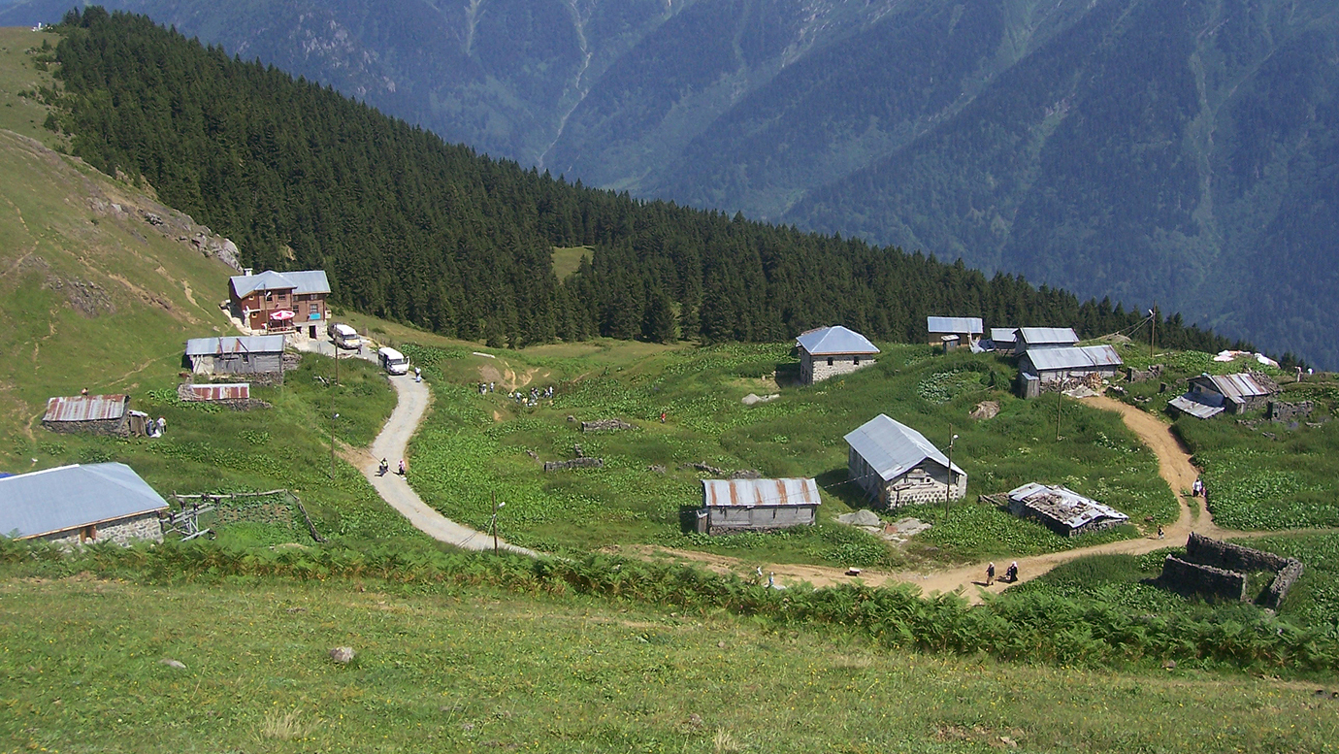
Notes:
The ratio of edges to nodes lets us know whether a graph is sparse or dense – sparse graphs have few connections per node and dense graphs many, so generally, we will always prefer sparse graphs as they’re cheaper to store and cheaper to process.
Sometimes we want to specify a graph that has directional connections between nodes – so a vertical drop is a valid move, but you can’t jump back up it again, or we may just have two different costs depending on which way we’re moving (if we’re going uphill, it’s more costly than if we were going back down the hill). This sort of graph representation is known as a “digraph”, which is a graph that has one way or directed edges.
When designing a data structure for our graphs, it’s often useful to think of undirected graphs as digraphs with two edges connecting each connected pair of nodes – this lets us represent both types of graph with a single data structure.

Slide 4
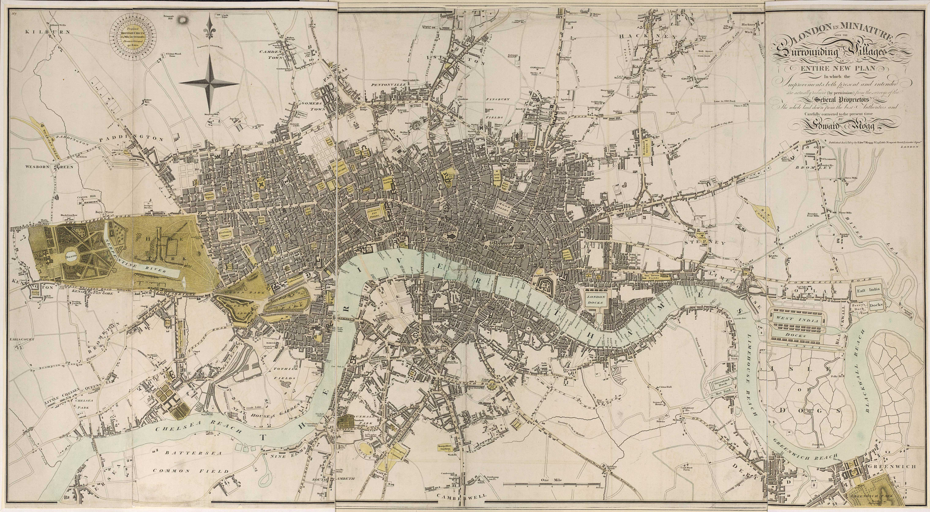
Notes:
Graphs actually see a lot of use in games; so we’ll take a look at a few of the common uses, starting with the most common: navigation graphs. A nav graph represents all of the locations of a game environment that an agent can visit and all of the connections between those points.
Each node in a nav graph tends to represent the position of a key area or object and each edge represents the connections between those points and each edge will have an associated cost – the distance as its simplest.
The representation of the graph differs from game to game, normally dependant on the genre requirements – a first person shooter is likely to use a waypoint system while an RTS or RPG may use a grid based graph with the center of each tile being a node.

Slide 5
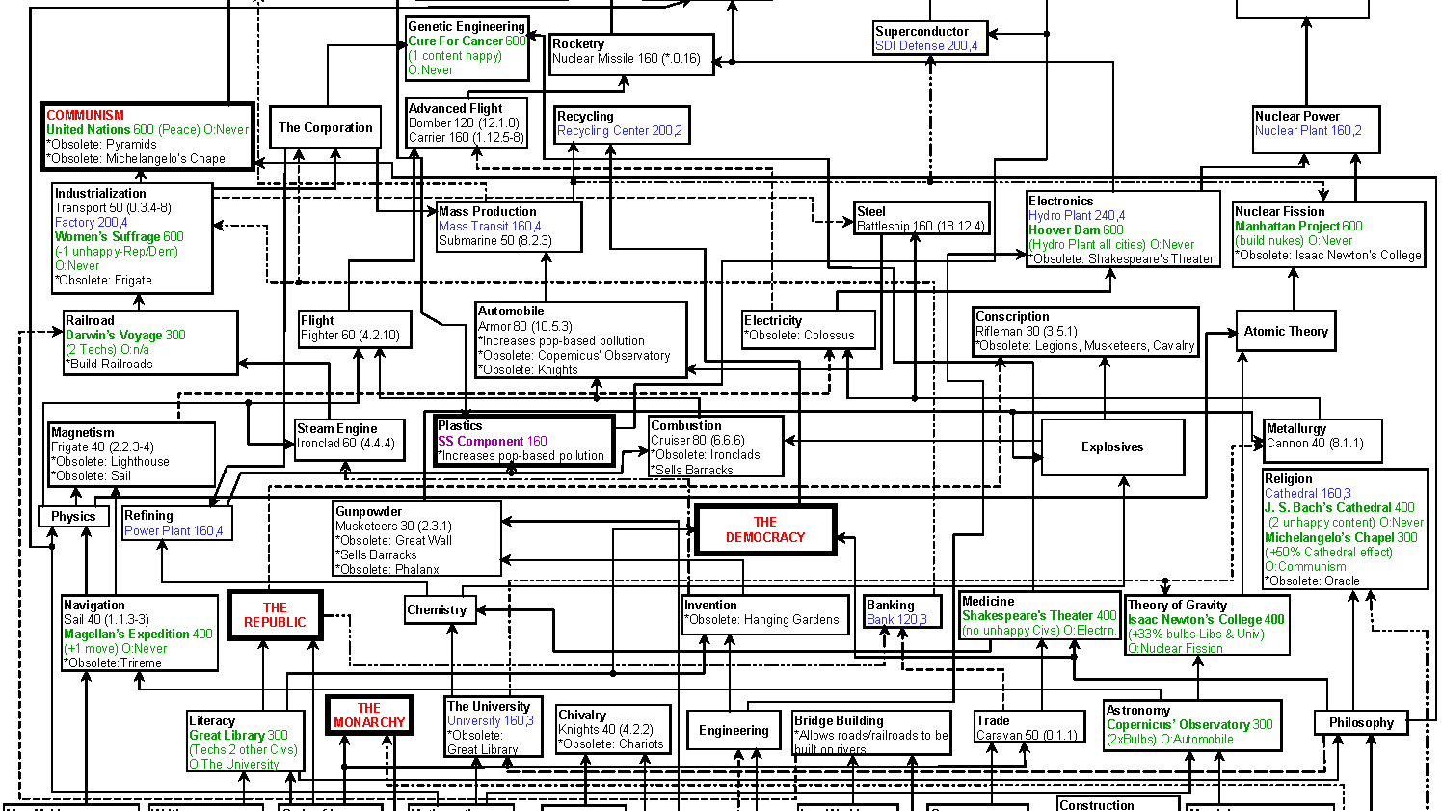
Notes:
Another type of graph that’s common in games is the dependency graph, which are particularly popular in games that require resource management as it’s a straightforward way to represent the dependencies between the various buildings, materials and units available to a player (either human or AI).
An AI can make use of this sort of graph to do a few things; it can plan what upgrades or buildings it requires to build a unit that it has decided it will be advantageous – so it runs through the graph and finds that to build archers, it needs barracks and a lumber mill, by investigating each of those nodes, it can decide which is more important due to the further unlocks each building offers.
Equally, if the AI see’s an enemy unit, it can look at the dependency graph to discover exactly what tech or buildings the enemy has to be able to build that unit by working backwards through the graph from the specific unit.

Slide 6

Notes:
Finally, we’ll talk about state graphs – which allow us to represent every possible a state that a system can be in, with the edges between nodes being the transitions between states. We can search the state space using the graph to see if a particular state is possible (or to then find the most efficient route to a specific state).
State graphs have a “root node” that indicates the initial state of the game space, the root node is then expanded out to all the states that can be reached from the initial state and then each of those nodes is expanded out again and so on. We can then search the graph to find a goal state – for some solutions that’s straight forward, but for others, where the state space is vast (think chess – with a branching factor of 35) we would quickly exceed the memory of the system.
So these complicated graphs (with a high branching factor) are typically created and searched by only expanding a few state nodes at a time, generally using an algorithm that will direct the search towards the goal state.

Slide 7

1
2
1
4
6
x | 1 | 2 | 3 | 4 | 5 | 6 | 7
1 | 0 | 0 | 0 | 1 | 0 | 1 | 0
2 | 0 | 0 | 0 | 1 | 1 | 0 | 0
3 | 0 | 0 | 0 | 1 | 0 | 0 | 0
4 | 1 | 1 | 1 | 0 | 0 | 0 | 0
5 | 0 | 1 | 0 | 0 | 0 | 0 | 1
6 | 1 | 0 | 0 | 0 | 0 | 0 | 0
7 | 0 | 0 | 0 | 0 | 1 | 0 | 0
2
4
5
3
4
3
4
4
5
1
2
3
5
2
7
6
1
1
2
6
7
5
7
3
4
5
6
7
Notes:
For a simple graph, the most straight forward representation is an adjacency matrix: we represent the graph in a 2d array, with the rows and columns representing the nodes of the graph and the values in the array being the costs associated with following that edge. We can either store these values as 0 or 1s, if there is no further cost involved, or we can use floats and more accurately represent the cost of traversing the edge.
For slightly more complicated graphs, we could use an adjacency list: so each node present in the graph stores a list of the edges (or nodes) that are adjacent to it.
There are plenty of ways to approach implementing a graph, if we don’t mind calculating the edge costs as we traverse it we can have a node class that just stores a list of other nodes it is adjacent to. Buckland puts forth an approach that has the graph store a list of nodes and also a list of edges between nodes (using the unique indices of the nodes). The benefit to this approach is that we can store the cost of an edge in the edges representation. Either are valid implementations, which is nice.

Slide 8

Notes:
We can use search algorithms to allow us to: visit every node in a graph, mapping the graph topology. Find any path between nodes, which is fine if we want to reach a node but don’t care how we get there. Or we can find the best path between nodes, which may be the shortest route in a nav graph or the path that takes into account enemy positions and plots around them.
If we don’t care about the cost of edges between nodes, we can undertake a blind search (otherwise known as an uninformed graph search), which can distinguish individual nodes and edges, which is the only information really required to completely explore a graph or find a path between two nodes. There are a couple of different approaches to blind searches, the first we’ll talk about is the depth first search. It works by moving as deeply into the graph as it can, once it reaches a dead end, it back tracks to a shallower node and tries again.

Slide 9

2
2
2
2
2
2
2
1
2
1
1
1
1
1
1
1
3
3
3
3
3
3
3
3
4
4
4
4
4
4
4
4
5
5
5
5
5
5
5
5
6
6
6
6
6
6
6
6
7
7
7
7
7
7
7
7
Notes:
So given a starting node, the algorithm selects an edge at random, it doesn’t matter which, as long as it’s not one that’s already been travelled. At each node, we generate a list of edges that lead from it and select a new path to follow. If the node has no adjacent edges, we reverse to the previous node we visited and pick a new path (again, ignoring those that lead to nodes we have already explored). This continues until there are no further new edges to look at – which means we have mapped (or explore) the entire graph. If we were searching for a specific node, at each traversal step, we would check if the node we had moved to was the target node, if it was, we could return the path (the list of previously visited nodes). This won’t find the most efficient route (it does not care about the costs between edges after all) but, if a path exists, it will find one!
We can use a stack of nodes to build a route; we start by pushing a starting node onto the stack, we then add all the adjacent nodes to the stack if they have not been marked as visited - we store the ‘parent’ of each node in a separate list (starting with our starting node flagged as a parent of itself), once we find our target node, we can walk backwards through the list of parents to create the route.

Slide 10
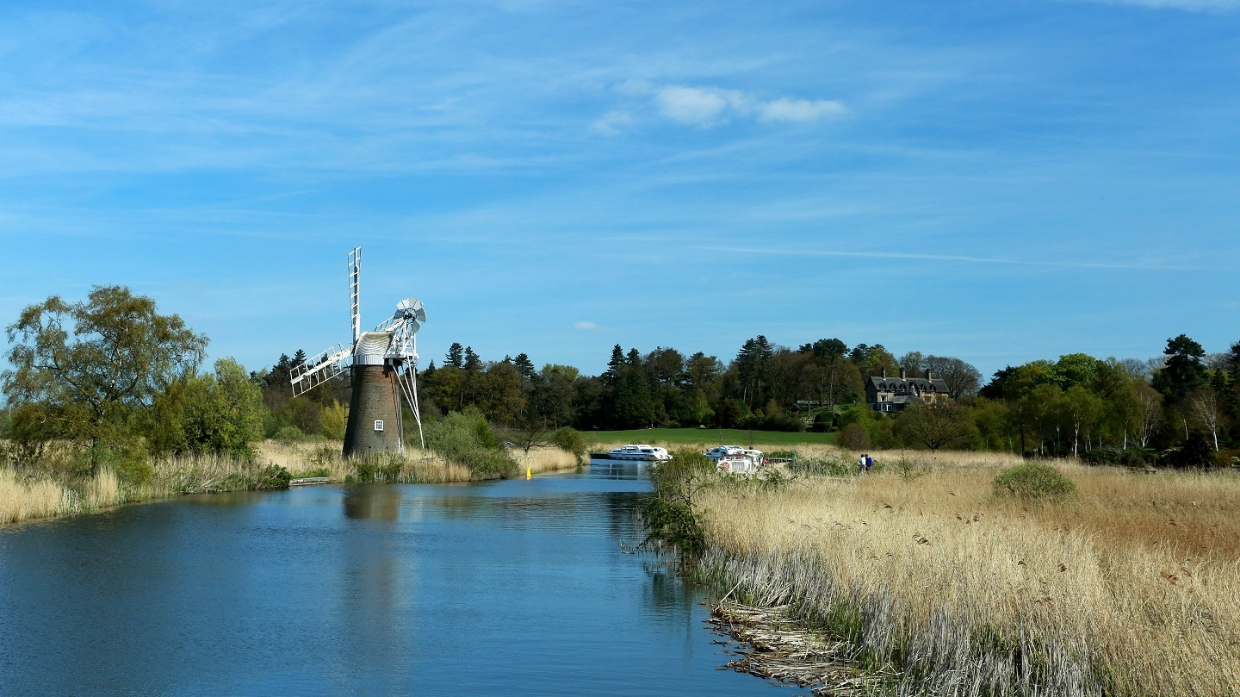
2
2
2
2
1
2
1
1
1
1
3
4
5
3
3
3
4
4
4
5
5
3
4
5
5
6
7
6
6
6
7
7
6
7
7
Notes:
A breadth first search checks through “levels” of a graph, rather than going as deep as it can before traversing back up the graph structure. So if it starts with a node that has 3 adjacencies, it will check all 3 of those adjacencies before moving further into the graph. The benefit of this approach is that it finds the shortest path available to use (in terms of edges traversed). We start by setting a distance value on each node to infinity (or as close as we can get) and setting its parent to null. We can then use a queue to organise our search, by starting with our “root” or starting node by enqueing it.
We then enter a loop that pulls the front element from queue and checks each of its adjacent nodes, if a node has an infinite distance we sets its distance to the current nodes distance + 1 and say that the current node is the parent of it, we then push that node onto the queue. If the node already has a distance value, it’s already been visited, so we can ignore it (it’s in the queue, so we’ll get round to it). We repeat this until the queue is empty. Once we find the target node, we can follow the chain of “parent” nodes back up to the starting point and build the route as we go.

Slide 11

Notes:
This seems great, but the fact is that this approach to searching a graph is incredibly slow, there’s nothing to guide the search in any particular direction, so while we will find a path if it exists, it could take an age (As pointed out by Buckland, a graph with a branching factor of 10, assuming it takes a millisecond to expand each node will take 3,500 years to reach a depth of 14…)
To improve upon that 3500 year search, we can start to factor in the cost of any given route; there are plenty of approaches that do this, but we’ll focus on a couple (that happen to be pretty closely related): Djikstra’s and A*.
It’s important to note that Djikstra’s search will result in hitting the same number of edges as a BFS does (which is why it has been surpassed by A* as an implementation). But it’s useful to understand the basics before we move on to A*.

Slide 12
3
3.1
2
0.8
3.7
1.9
5
4
2.9
3.0
1
1.1
6
1.0
Notes:
We assign every node a tentative distance value (0 for the root, infinity for the rest of the graph),
set the initial node as current and mark the rest as unvisited. Create a set of all of the unvisited nodes called the unvisited set (we can use lists or vectors to do this).
For the current node, consider all its unvisited neighbours and calculate their tentative distance – which is the cumulative distance from the parent node, if that value is less than the currently assigned distance to the node, we replace it (so the first visit will always overwrite the infinite value, further visits may or may not drop the distance to the node).
When we are done considering all the neighbours of the current node, we mark it as visited and remove it from the unvisited set.
If the destination node has been marked as visited, then we stop as the algorithm has finished.
Otherwise, select the unvisited node with the lowest tentative distance, set it as the new current node and go to 3.

Slide 13

3
3.1
2
0.8
3.7
1.9
5
4
2.9
3.0
1
1.1
6
1.0
Notes:
A* works by helping us to refine our cost assessment using something called a “heuristic”, which lets us guide the search path, allowing us to stop following more costly paths.
The main change we have over djikstras is that we compute a heuristic value that we add to our combined cost value – typically, this is the distance from the node being investigated and the target node (a straight line distance is known as a “Euclidean” distance, if we’re working in a grid based graph, we can use the “Manhattan” distance, which is the horizontal and vertical displacement).
The cost equation looks like f(n) = g(n) + h(n) where g is the cost from the start of the path to the current node and h is the heuristic. By representing the set of unvisited nodes with a priority queue, we can guarantee that the next node we visit is the one that has the lowest overall cost, so we’re “guiding” the algorithm to try to always move towards the goal node. In fact, we can consider Djikstras to be a special case of A* where the value of h is always set to 0… Just to be confusing and all!

Slide 14
Portfolio Assignment
Implement Djisktra’s algorithm and A*
Bonus points for also implementing DFS and BFS.
You should try to visualise the algorithm, allowing a user to view the steps taken.
For path finding, allow a user to select a nodes to route search between.
Take a look at:
http://www.policyalmanac.org/games/aStarTutorial.htm
http://www.redblobgames.com/pathfinding/a-star/introduction.html
http://theory.stanford.edu/~amitp/GameProgramming/
You have three weeks

